Slide 1
Session 4
Transact-SQL Language
Notes:
ACCP2005/ Developing Enterprise Applications 2.0/ Session 1/ of 23

Slide 2
Session Objectives
Liệt kê các tính năng chính của Transact-SQL
Hiểu được biến, kiểu dữ liệu, chú thích
Tóm tắt các hàm, biểu thức trong Transact-SQL
Giải thích ngôn ngữ định nghĩa dữ liệu và các lệnh của ngôn ngữ định nghĩa dữ liệu
Giải thích ngôn ngữ thao tác dữ liệu và các lệnh của ngôn ngữ thao tác dữ liệu
Giải thích ngôn ngữ điều khiển dữ liệu và các lệnh của ngôn ngữ điều khiển dữ liệu
Giải thích cách thực thi câu lệnh Transact-SQL:
  Một câu lệnh đơn lẽ
  Tập lệnh
  Scripts
Liệt kê và giải thích những tính năng nâng cao của Transact-SQL
Notes:
ACCP2005/ Developing Enterprise Applications 2.0/ Session 1/ of 23

Slide 3
Transact-SQL Language -1
Structured Query Language (SQL) là một ngôn ngữ rất phổ dụng trong lĩnh vực CSDL.
Microsoft xây dựng Transact-SQL dựa trên ngôn ngữ vấn tin có cấu trúc chuẩn.
Nó cung cấp một ngôn ngữ bao hàm toàn diện để định nghĩa bảng, chèn, xóa, thay đổi và truy cập dữ liệu trong bảng.
Transact-SQL là một ngôn ngữ mạnh, nó hỗ trợ các tính năng khác như: kiểu dữ liệu, đối tượng tạm thời, thủ tục lưu trữ và thủ tục hệ thống.
Nó còn cho phép chúng ta định nghĩa đối tượng con trỏ, khai báo biến, cấu trúc rẽ nhánh, vòng lặp, bẫy lỗi và Transaction.

Slide 4
Transact-SQL Language -2
Example for Transact-SQL statement:
SELECT * FROM Employee
The statement retrieves all records from Employee table.

Slide 5
Variables in Transact-SQL - 1
Biến là vùng nhớ trong bộ nhớ được đặt tên để chứa giá trị dữ liệu. Dữ liệu có thể truyền cho câu lệnh SQL bằng biến cục bộ. Tên biến cục bộ phải khai báo bắt đầu bằng ký hiệu @.
Biến có thể phân thành 2 loại:
  Local Variables (Biến cục bộ)
  Global Variables (Biến toàn cục)

Slide 6
Variables in Transact-SQL - 2
Local Variables
  Trong Transact-SQL, biến cục bộ được khai báo và sử dụng tạm thời khi thực thi câu lệnh SQL.
  Cú pháp:
  where,
      @local_variable specifies the name of a variable.
      Variable names must begin with the ‘@’.
      data_type is a system or user-defined data type.
DECLARE
{
@local_variable [AS] data_type
}

Slide 7
Variables in Transact-SQL - 3
Câu lệnh SET hoặc SELECT dùng để gán giá trị cho biến.
Cú pháp:
        SET @local_variable = value
Hoặc
SELECT @local_variable = value

Slide 8
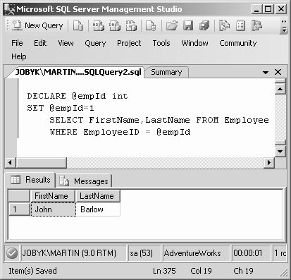
Variables in Transact-SQL - 4
Ví dụ: DECLARE @empID int
SET @empID = 1
SELECT FirstName, LastName FROM Employee
WHERE EmployeeID = @empID

Slide 9
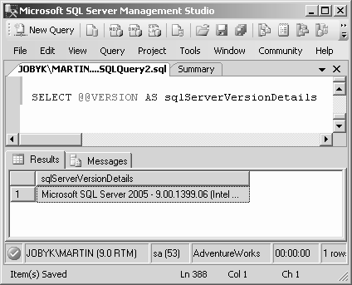
Variables in Transact-SQL - 5
Global Variables
  Biến toàn cục là biến có sẵn và hệ thống quản lý.
  Biến toàn cục trong SQL Server được đặt tên bắt đầu bởi hai ký hiệu @.
Ví dụ:
  SELECT @@VERSION AS 'SQL Server version'

Slide 10
Data Types in Transact-SQL - 1
Kiểu dữ liệu là thuộc tính định nghĩa loại dữ liệu mà đối tượng có thể chứa.
Transact-SQL bao gồm nhiều kiểu dữ liệu chẳng hạn như: varchar, text, int,....
Các đối tượng dưới đây sử dụng kiểu dữ liệu:
  Cột trong bảng
  Biến
  Tham số trong thủ tục lưu trữ
  Hàm trả về giá trị
  Thủ tục lưu trữ trả về giá trị

Slide 11
Data Types in Transact-SQL - 2
Data Types in SQL Server 2005
tinyint | real | datetime | varbinary
smallint | char | smalldatetime | uniqueidentifier
int | nchar | image | numeric
bigint | varchar | money | timestamp
bit | nvarchar | smallmoney | sql_variant
decimal | text | xml | table
float | ntext | cursor | binary

Slide 12
Comments in Transact-SQL - 1
Microsoft SQL Server hỗ trợ hai loại chú thích sau:
  -- chú thích một dòng
  /* . . . */ chú thích nhiều dòng

Slide 13
Data Definition Language
Data Definition Language (DDL), được dùng để định nghĩa (xây dựng), thay đổi hoặc xóa cấu trúc của các đối tượng CSDL, chẳng hạn: bảng, view, trigger, thủ tục lưu trữ, …
Câu lệnh DDL:
  CREATE object_name
  ALTER object_name
  DROP object_name
  Với object_name: TABLE, VIEW, …

Slide 14
CREATE DATABASE – Example 1
CREATE DATABASE NhanSu
ON PRIMARY
(NAME = NhanSu_DATA,
FILENAME = 'C:\SQL\Tdata\NhanSu.mdf'
)
LOG ON
(NAME = NhanSu_LOG,
FILENAME = 'c:\sql\Tdata\NhanSu.ldf'
)

Slide 15
CREATE DATABASE - Example 2
create database BookStores
on primary (
name=‘BookStores_data',
filename='C:\inetpub\wwwroot\project\database\ BookStores.mdf',
size=2MB,
maxsize=50MB,
filegrowth=10%
)
log on (
name=' BookStores _log',
filename='C:\inetpub\wwwroot\project\database\ BookStores.ldf',
size=2MB,
maxsize=50MB,
filegrowth=10%
)

Slide 16
CREATE TABLE
CREATE TABLE statement
  The CREATE TABLE statement creates a table in an existing database.
Syntax:
Example:
CREATE TABLE <Table_Name>
(Column_Name1 Data_Type, Column_Name2 Data_Type,...,
Column_NameN Data_Type )
CREATE TABLE Contacts
(MailID varchar(20),
Name text,
TelephoneNumber int)

Slide 17
Data Types in SQL
Characters:
  CHAR(20) -- fixed length
  VARCHAR(40) -- variable length
Numbers:
  BIGINT, INT, SMALLINT, TINYINT
  REAL, FLOAT -- differ in precision
  MONEY
Times and dates:
  DATETIME
  TIMESTAMP
Binary objects (such as pictures, sound, etc.)
  BLOB -- stands for “Binary Large OBject”
Others... All are simple

Slide 18
Column attributes in SQL
Keys:
  PRIMARY KEY -- primary key of the table
  KEY -- foreign key (will be indexed)
  INDEX -- field to be indexed for fast search
Null values:
  NOT NULL -- field must be filled in
Default value:
  DEFAULT ‘value’ -- value to be used if user gives none

Slide 19


Column Nullability
The nullability feature of a column determines whether rows
in the table can contain a null value for that column.
Nullability of a column can be defined either when creating
a table or modifying a table.
NULL keyword indicates that null values are allowed
in the column.
NOT NULL keywords indicate that null values are not
allowed in columns.
Example:
CREATE TABLE StoreDetails
(StoreID int NOT NULL, Name varchar(40) NULL)

Slide 20

DEFAULT Definition -1
A DEFAULT definition can be given for a column to assign it a default value if no value is given at the time of creation.
A DEFAULT definition for a column can be created at the time of table creation or added at a later stage to an existing table.

Slide 21
DEFAULT Definition - 2
Example:
CREATE TABLE StoreProduct( ProductID int NOT NULL, Name varchar(40) NOT NULL, Price money NOT NULL DEFAULT (100))
Example:
INSERT INTO StoreProduct (ProductID, Name) VALUES (111, ‘Rivets’)

Slide 22
DEFAULT Definition -3
DEFAULT definitions cannot be created on columns defined with:
A timestamp data type
An IDENTITY or ROWGUIDCOL property
An existing default definition or default object

Slide 23
IDENTITY Property -1
Syntax:
CREATE TABLE <table_name> (column_name data_type [ IDENTITY [(seed_value, increment_value)]] NOT NULL )
where,
  seed_value is a value from which identity values will start.
  increment_value is an increment value by which to increase the identity
  value each time.
Example:
CREATE TABLE ContactPhone ( Person_ID int
IDENTITY(500,1) NOT NULL, MobileNumber bigint NOT NULL )
Here, in this example, 500 is the seed identity value and 1 is the increment.

Slide 24
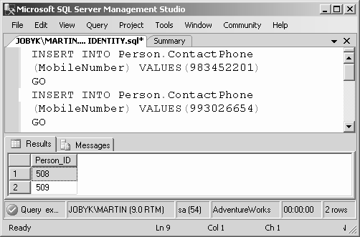
IDENTITY Property -2
Later, if a SELECT statement is written to display only the Person ID, the output can be seen as shown.
Example:
INSERT INTO ContactPhone VALUES (983452201)
GO
INSERT INTO ContactPhone VALUES (993026654)
GO

Slide 25
CREATE TABLE
create table monHoc
(maMH char(10) primary key,
tenMH nvarchar(50))
create table sinhVien
(maSV char(10) primary key,
tenSV nvarchar(30),
ngaySinh smallDateTime,
diachi nvarchar(50))

Slide 26
create table ketQua
(maSV char(10),
maMH char(10),
diem real,
primary key (maSV,maMH),
foreign key (MaSV) references sinhVien, foreign key (maMH) references monHoc
)

Slide 27
ALTER TABLE
ALTER TABLE statement
  The ALTER TABLE statement is used to modify a table definition by altering, adding, or dropping columns and constraints or by disabling or enabling constraints.
Syntax:
ALTER TABLE <Table_Name> ALTER COLUMN [<Column_name>
<New_data_type>]| ADD [<Column_name> <Data_Type>]
| DROP COLUMN [<Column _Name>]
where,
<Table_Name> is the name of the table to be modified.
ALTER COLUMN specifies the column to be changed or altered.
<Column_Name> names the column to be altered, added or dropped.
<New_data_type> is the new data type for the altered column.
ADD specifies a column to be added to the table.
DROP COLUMN specifies the column to be removed from the table.

Slide 28
ALTER TABLE example
1. Create
CREATE TABLE SinhVien(
MaSV char(6) PRIMARY KEY,
TenSV nvarchar(30) NOT NULL,
Tuoi int
)
2. Add a column named DiaChi with data type nvarchar(50) into SinhVien table
ALTER TABLE SinhVien
ADD DiaChi nvarchar(50)
3. change from a column named TenSV to nvarchar(40)
ALTER TABLE SinhVien
ALTER COLUMN TenSV nvarchar(40)
4. delete a column named DiaChi
ALTER TABLE SinhVien
DROP COLUMN DiaChi

Slide 29
DROP DATABASE & TABLE
DROP DATABASE/TABLE statement
  The DROP DATABASE statement removes all tables
  The DROP TABLE statement removes a table definition and all data, indexes, triggers, constraints, and permission specifications for that table.
Syntax:
  where,
    <Database_Name/Table_Name> is the name of the Database or the table to be modified.
DROP DATABASE/TABLE <Database_Name/Table_Name>
ATTN: All data will be destroyed along with the table.
The system will not ask twice!

Slide 30
CONVERT
  Conversion Functions
  Syntax:
    Where,
    datatype: datatype is needed conversion
    Length : length of data
    Expression: specifies name of column,const, function, variable or subquery
    Style: specifies styles of date (dd/mm/yyyy hay mm/dd/yyyy)
    Example:
      SELECT 'Employee ID: ' + convert(char(4), EmployeeID)
      FROM Employee
CONVERT(datatype[(length)],expression [,style]

Slide 31
Convert & Cast
--dd/mm/yyyy
select convert(char(12),getdate(),103)
--dd/mm/yy
select convert(char(12),getdate(),3)
print cast(1234 as char(20))
--Jan 10 2009 10:58PM
print cast(getdate() as char(20))
print CONVERT(int, '5678')
print CONVERT(decimal(5,2), '123.456789')

Slide 32
Data Manipulation Language
Data manipulation language is used to select, insert, update, and delete data in the objects defined with DDL.
There are three types of Data Manipulation Languages:
  SELECT statement
  INSERT statement
  UPDATE statement
  DELETE statement

Slide 33
INSERT (1)
The INSERT statement adds a new row to a table.
Syntax:
INSERT INTO <Table_name>
VALUES <Values>
where,
<Table_Name> is the name of the table in which row is to be inserted.
[INTO] is an optional keyword used between INSERT and the target table.
    <Values> specifies the values for columns of the table.
Example:
USE AdventureWorks
INSERT INTO Contacts
VALUES(‘john@abc.com’,’John’,5432677,5432678)
This statement adds a new row to the table Contacts.

Slide 34
INSERT (2)
insert into monHoc values ('CF','Computer fundamentals')
insert into monHoc values ('C','Elementary Programming with C')
insert into sinhVien values ('01','Tran Van Cong', '1986-12-30','HN')
insert into sinhVien (maSV,tenSV) values ('05','Tran Tho Ngo')

Slide 35
SELECT (1)
SELECT statement
  The SELECT statement retrieves rows from the database and enables the selection of one or many rows or columns from a table.
Syntax:
where,
<Table_name> is the name of the table from which rows are to be retrieved.
<Column_name(s)> is the name of the column or the names of the columns to be retrieved.
SELECT <Column_name(s)> FROM <Table_name>

Slide 36
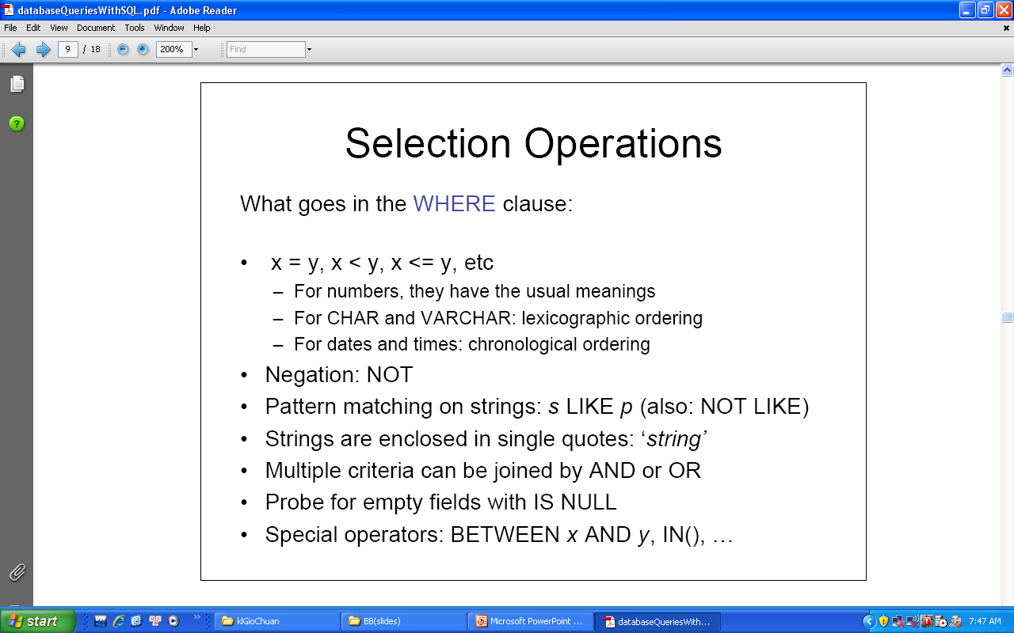

Slide 37
Operators
Operator | Description
= | Equal to
<> | Not equal to
> | Greater than
< | Less than
>= | Greater than or equal to
<= | Less than or equal to
! | Not
BETWEEN | Between a range
LIKE | Search for an ordered pattern
IN | Within a range

Slide 38
Wild Card characters
Wildcard | Description | Example
_ | It will display a single character. | SELECT * FROM Person.Contact WHERE Suffix LIKE ‘Jr_’
% | It will display a string of any length. | SELECT * FROM Person.Contact WHERE LastName LIKE ‘B%’
[ ] | It will display a single character Within the range enclosed in the Brackets. | SELECT * FROM Sales.CurrencyRate WHERE ToCurrencyCode LIKE ‘C[AN][DY]’
[^] | It will display any single character not within the range enclosed in the Brackets. | SELECT * FROM Sales.CurrencyRate WHERE ToCurrencyCode LIKE ‘A[^R][^S]’

Slide 39
Select (2)
select * from monHoc
select * from monHoc where maMH like 'C%'
select * from monHoc where maMH like '%F%'
select maSV, tenSV, convert(char(12),ngaysinh,103) as ngaysinh from sinhVien where diachi in ('HP','HN')
select maSV, tenSV,cast(ngaysinh as char(12)) from sinhVien where ngaySinh between '1986-1-1' and '1986-12-31'

Slide 40
Select (3)
select a.TenSV, b.MaMH, b.diem from sinhVien a, ketQua b where a.maSV = b.MaSV
select top 3 * from ketQua
select top 25 percent * from ketQua
select a.TenSV, b.MaMH, b.diem from sinhVien a inner join ketQua b on a.maSV = b.MaSV
select a.TenSV, b.TenMH, c.diem from sinhVien a, monHoc b, ketQua c where a.maSV = c.MaSV and b.maMH = c.maMH

Slide 41
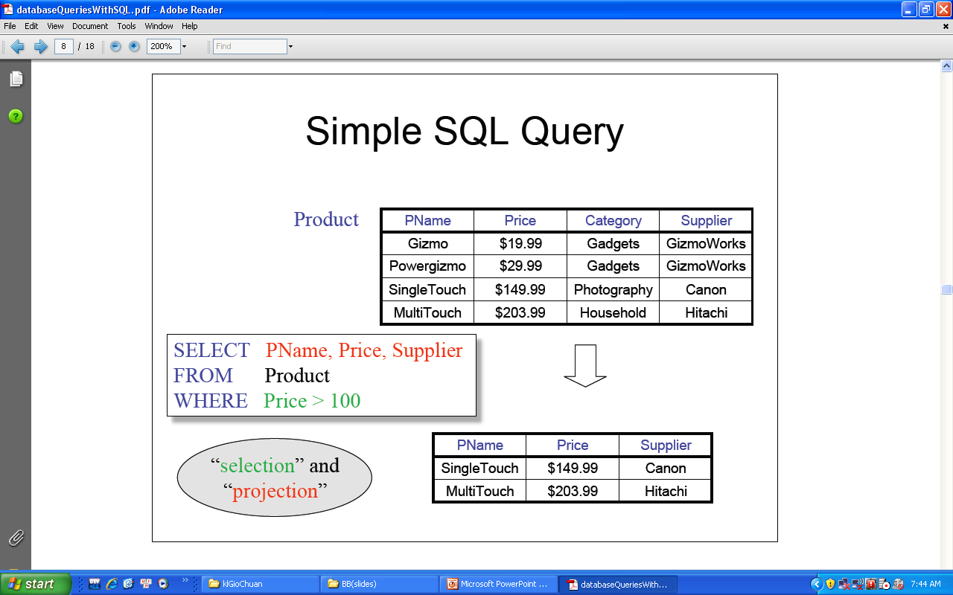

Slide 42
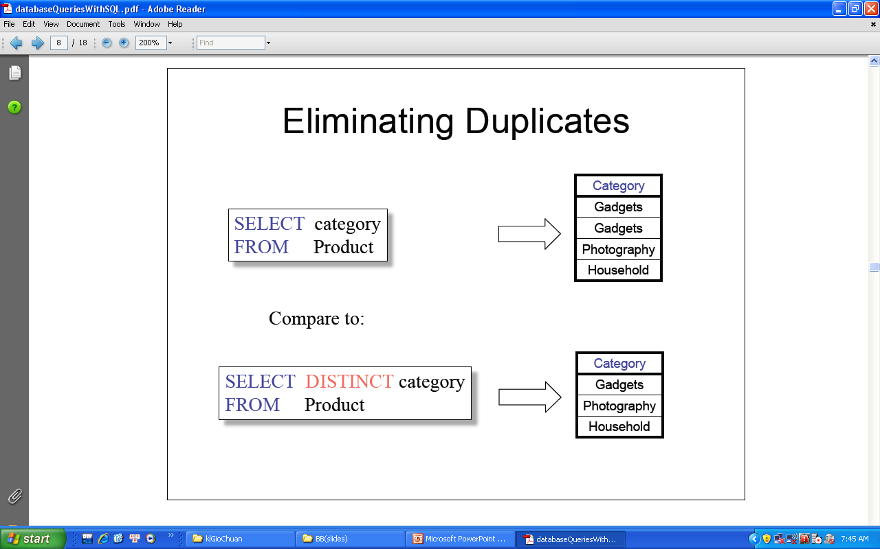

Slide 43
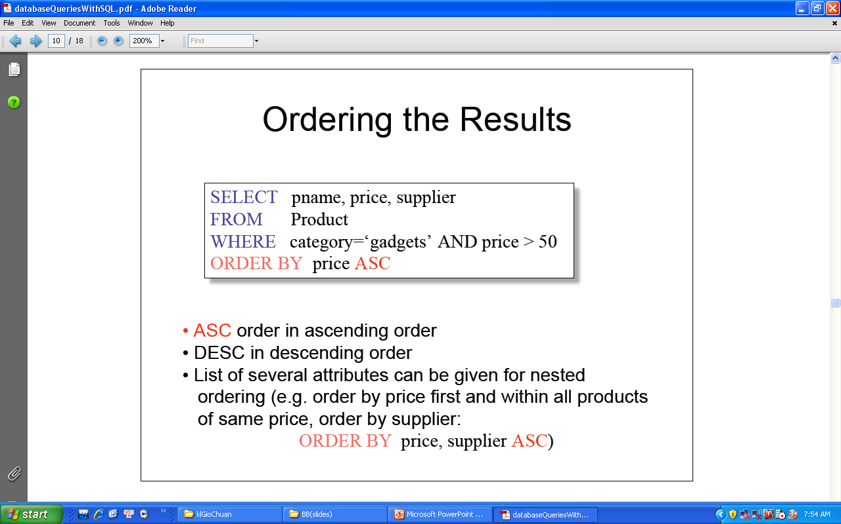

Slide 44
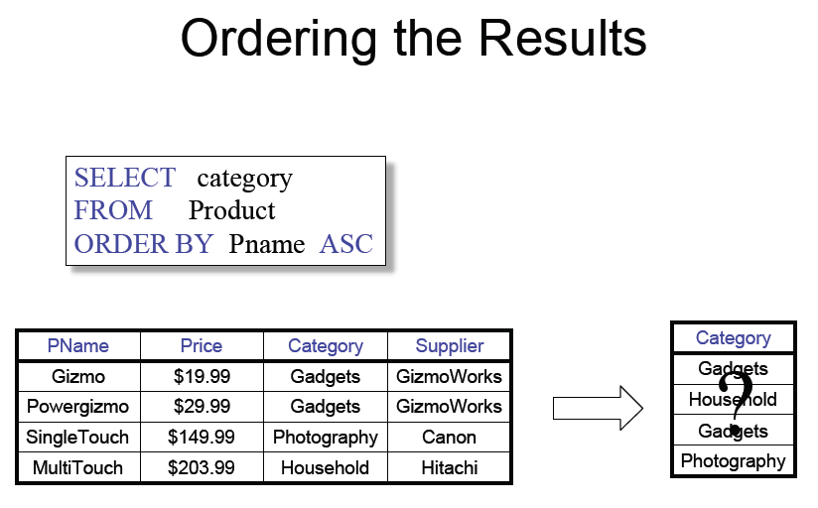

Slide 45
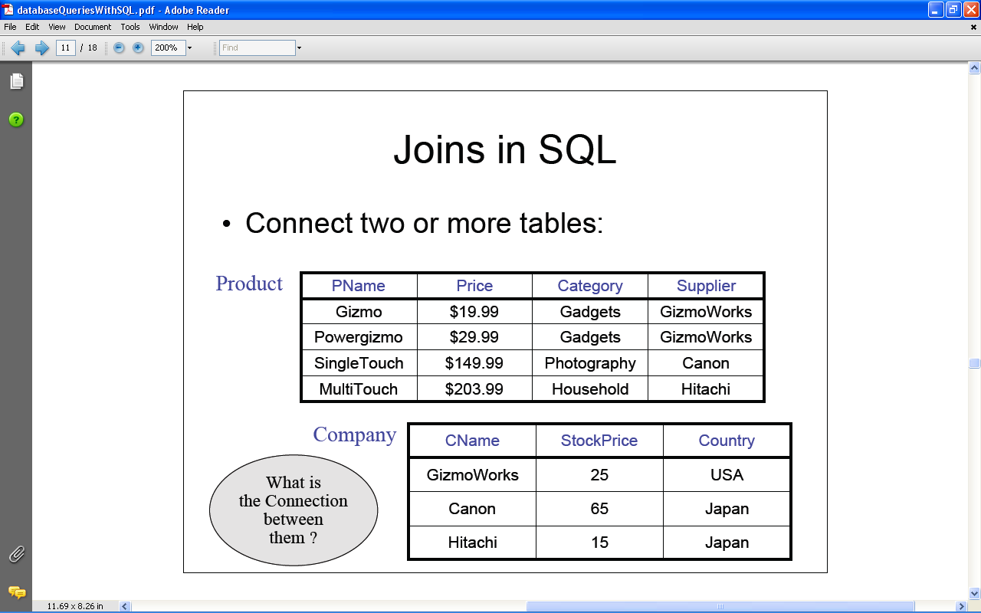

Slide 46
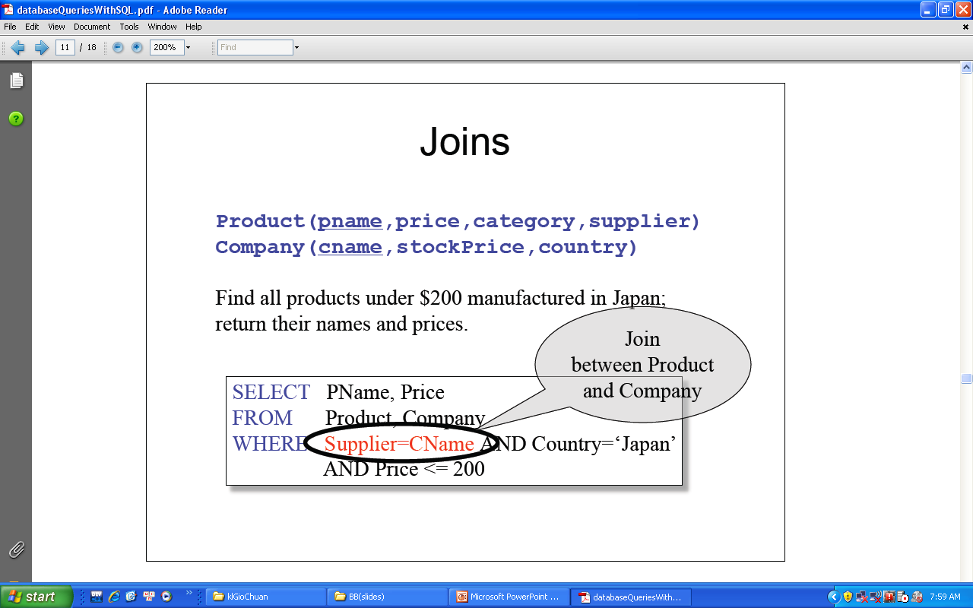

Slide 47
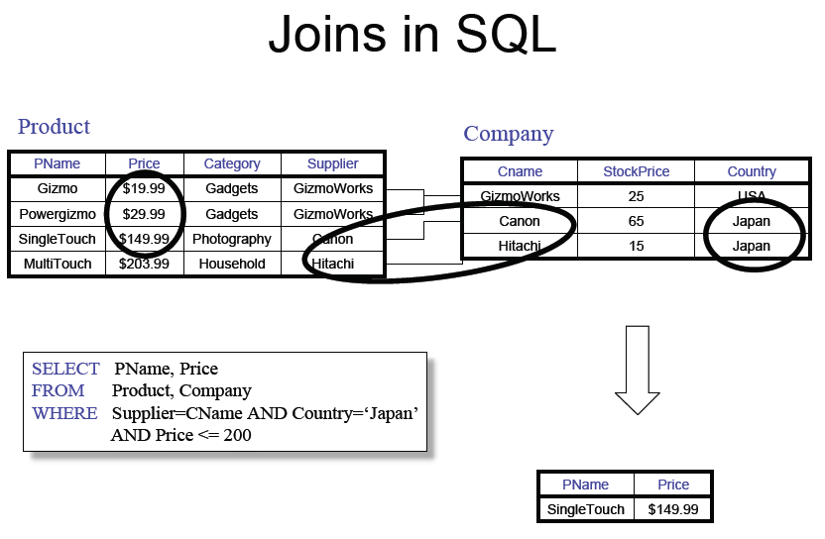

Slide 48
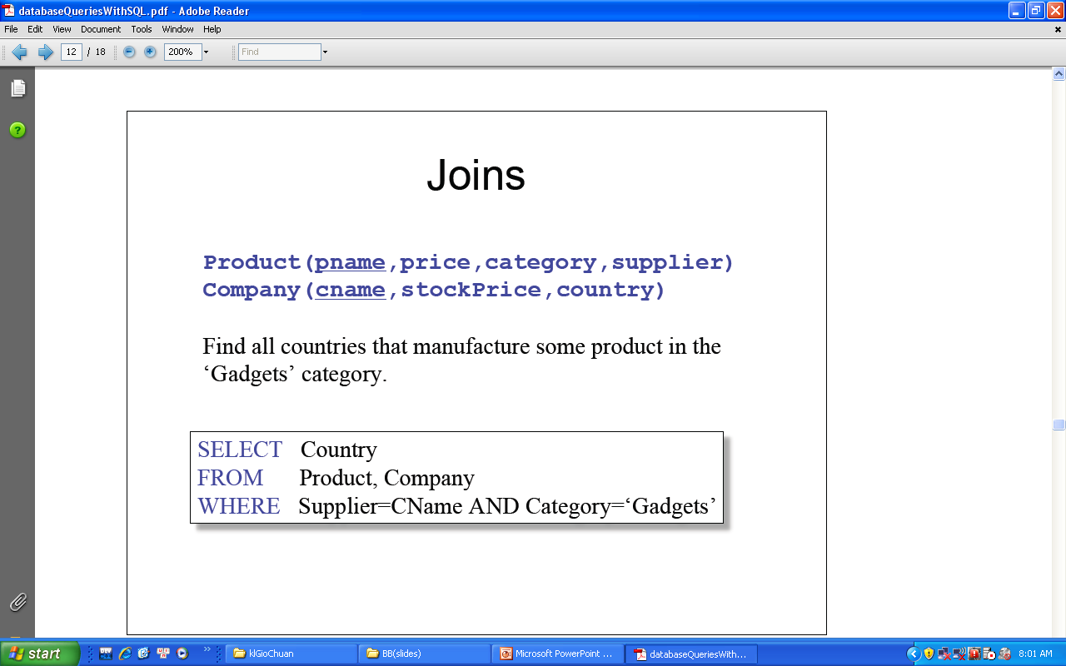

Slide 49
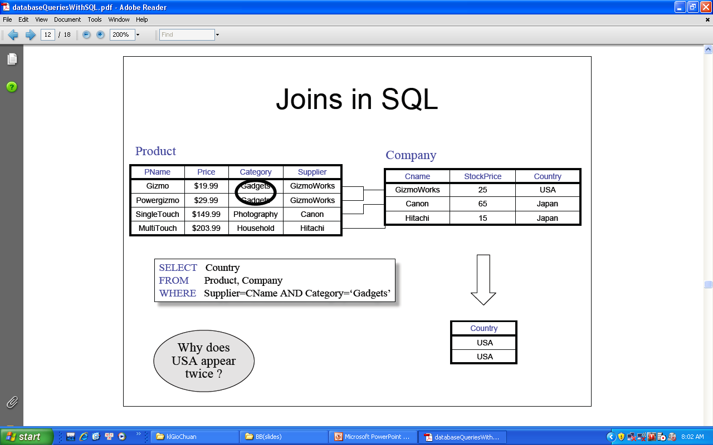

Slide 50
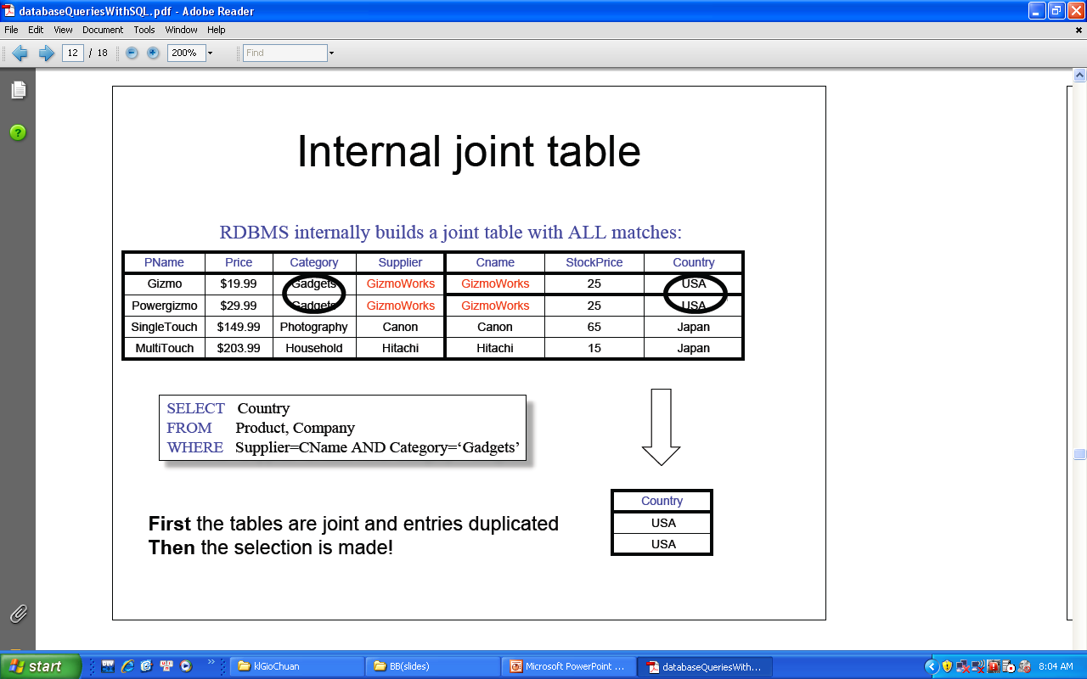

Slide 51
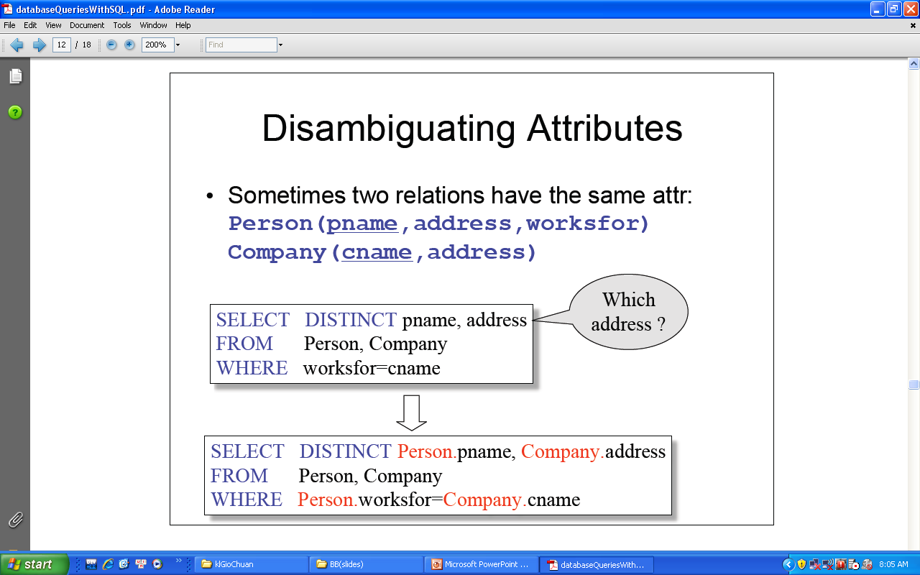

Slide 52
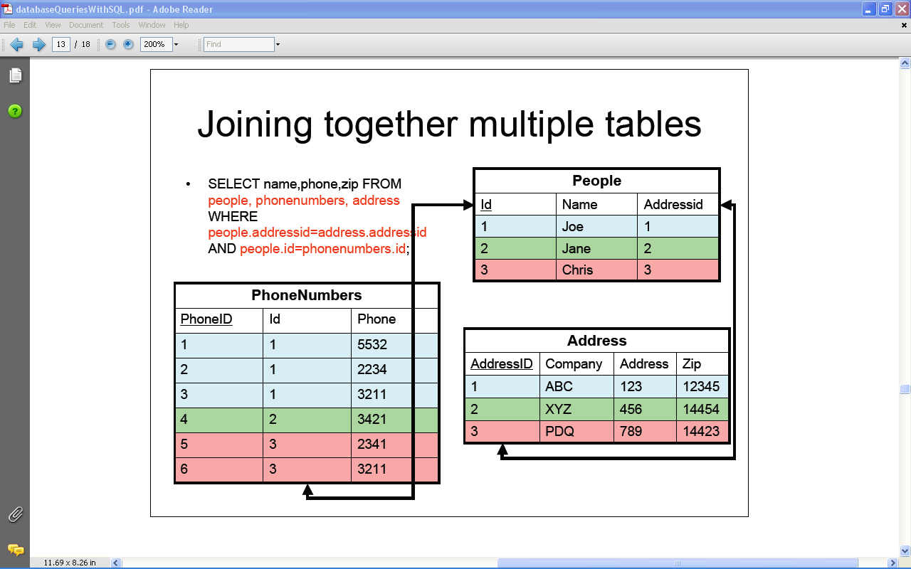

Slide 53
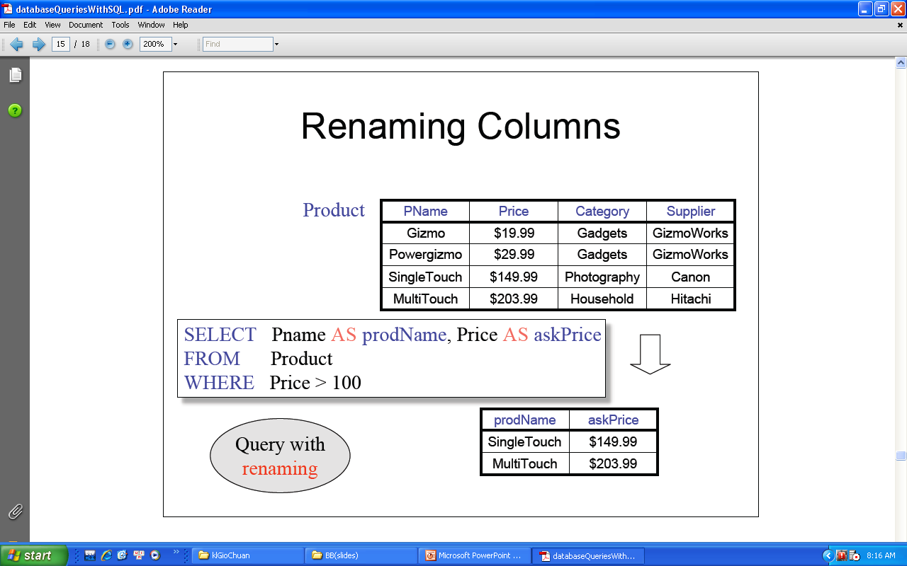

Slide 54
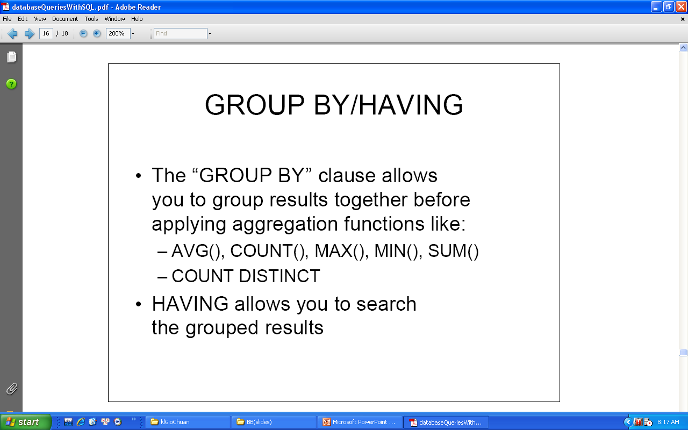

Slide 55
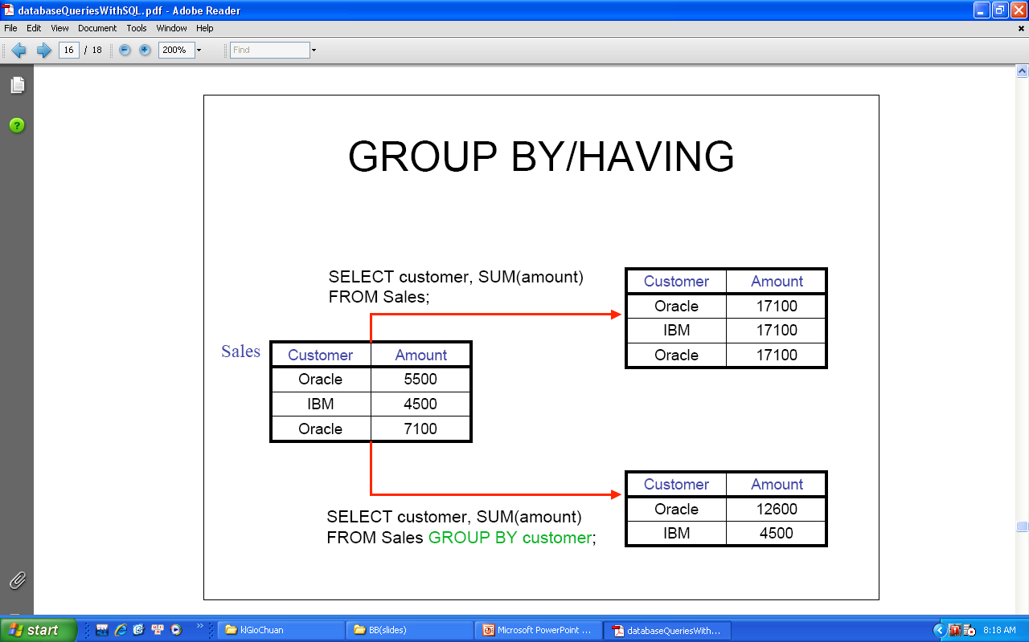

Slide 56
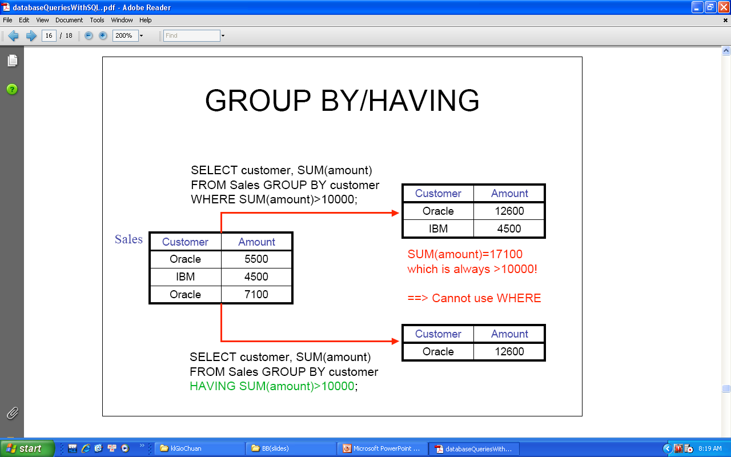

Slide 57
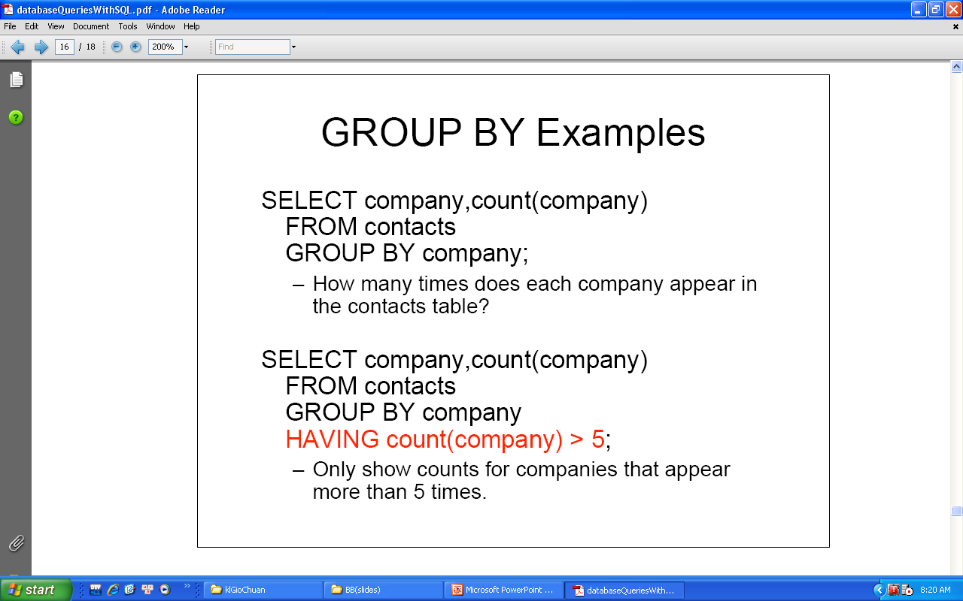

Slide 58
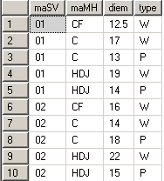
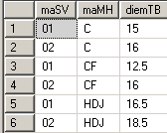

Group by
select maSV, maMH, avg(diem) as diemTB from ketQua group by maSV, maMH
select maSV, maMH, avg(diem) as diemTB from ketQua where maMH like 'C%' group by maSV, maMH having avg(diem)>14 order by maSV, maMH

Slide 59
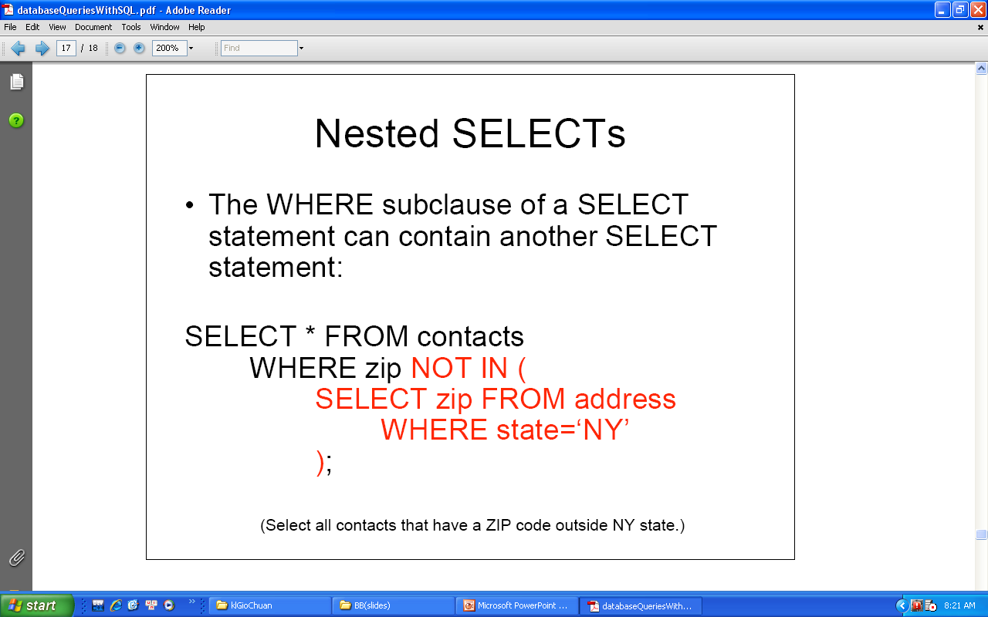

Slide 60
Update (1)
  UPDATE statement
    The UPDATE statement modifies the data in the table.
    Syntax:
where,
<Table_Name> is the name of the table in which row is to be inserted.
<Column_Name> is the name of the column in the table in which record is to be updated.
<Value> specifies the new value for the modified column.
<Search condition> specifies the condition to be met for the rows to be deleted.
UPDATE <Table_name>
SET <Column_Name = Value>
[WHERE <Search condition>]

Slide 61
Update (2)
create table monHoc (maMH char(10) primary key, tenMH nvarchar(50), wtest bit,ptest bit)
insert into monHoc (MaMH, tenMH) values ('CF','Computer fundamentals')
insert into monHoc (MaMH, tenMH) values ('C','Elementary Programming with C')
insert into monHoc (MaMH, tenMH) values ('HDJ','HTML, DHTML and JavaScript')
update monHoc set wtest=1
update monHoc set ptest=1 where MaMH in ('C','HDJ')
update monHoc set ptest=0 where MaMH ='CF'

Slide 62
Delete (1)
DELETE statement
    The DELETE statement removes rows from a table.
  Syntax:
where,
<Table_Name> is the name of the table in which row is to be inserted.
WHERE clause is to specify the condition. If where clause is not included in the DELETE statement, all the records in the table will be deleted.
<Search condition> specifies the condition to be met for the rows to be deleted.
DELETE FROM <Table_name>
[WHERE <Search condition>]

Slide 63
Delete (2)
create table monHoc
(maMH char(10) primary key,
tenMH nvarchar(50),
wtest bit,
ptest bit)
insert into monHoc (MaMH, tenMH) values ('CF','Computer fundamentals')
insert into monHoc (MaMH, tenMH) values ('C','Elementary Programming with C')
insert into monHoc (MaMH, tenMH) values ('HDJ','HTML, DHTML and JavaScript')
delete from monHoc where maMH ='C'
delete from monHoc

Slide 64
CASE
Evaluates a list of conditions and returns one of multiple possible result expressions.
CASE can be used in any statement or clause that allows a valid expression. For example, you can use CASE in statements such as SELECT, UPDATE, DELETE and SET, and in clauses such as select_list, IN, WHERE, ORDER BY, and HAVING.

Slide 65
Systax:
Simple CASE expression:
CASE input_expression
WHEN when_expression THEN result_expression [ ...n ]
[ ELSE else_result_expression ]
END
Searched CASE expression:
CASE
WHEN Boolean_expression THEN result_expression [...n]
[ ELSE else_result_expression ]
END

Slide 66
Case – Example 1
UPDATE CLASS
set TimeSlot =
CASE
when right(ClassCode,1)='G' then '7:30 - 9:30'
when right(ClassCode,1)='H' then '9:30 - 11:30'
when right(ClassCode,1)='I' then '13:30 - 15:30'
when right(ClassCode,1)='K' then '15:30 - 17:30'
when right(ClassCode,1)='L' then '17:30 - 19:30'
when right(ClassCode,1)='M' then '19:30 - 21:30'
ELSE 'unknown'
END

Slide 67
Case – Example 2
SELECT ProductNumber, Name, 'Price Range' =
CASE
WHEN ListPrice = 0 THEN 'not for resale'
WHEN ListPrice < 50 THEN 'Under $50'
WHEN ListPrice >= 50 and ListPrice < 250 THEN 'Under $250'
WHEN ListPrice >= 250 and ListPrice < 1000 THEN 'Under $1000'
ELSE 'Over $1000'
END
FROM Product
ORDER BY ProductNumber ;

Slide 68
Case – Example 3
update books set [type]=
case
when Totalpage<100 then 'thin'
when Totalpage between 100 and 1000 then 'normal'
when TotalPage>1000 then 'thick'
end

Slide 69
Functions in Transact-SQL 1-7
A function is a set of Transact-SQL statements that is used to perform some task.
SQL functions work on the data or group of data to return a required value.
Transact-SQL contains the following categories of functions:
  Aggregate Functions
  Conversion Functions
  Date Functions
  Mathematical Functions
  System Functions
  Ranking Functions

Slide 70
Functions in Transact-SQL 2-7
Aggregate Functions
    Transact-SQL provides aggregate functions to assist with the summarization of large volumes of data.
Function | Return Value | Example
SUM(col_name) | Returns the summation of a series of values | SELECT SUM(OrderQty) AS Total FROM PurchaseOrderDetail
AVG(col_name) | Returns average of a series of values | SELECT AVG(UnitPrice * OrderQty) AS AveragePrice FROM PurchaseOrderDetail
COUNT | Returns the number of records in a table that meet a given criteria | SELECT COUNT(*) AS ‘Number of Large Orders’ FROM PurchaseOrderDetail WHERE OrderQty > 100
MAX(col_name) | Returns the maximum value from a series of values | SELECT MAX(OrderQty * UnitPrice) AS ‘Largest Order’ FROM PurchaseOrderDetail
MIN(col_name) | Returns the minimum value from a series of values | SELECT MIN(OrderQty * UnitPrice) AS ‘Smallest Order’ FROM PurchaseOrderDetail

Slide 71
SUM([ALL | DISTINCT] expression)
AVG([ALL | DISTINCT] expression)
COUNT([ALL | DISTINCT] expression)
COUNT(*)
MAX(expression)
MIN(expression)
where
  SUM and AVG function works with numerical expression
  SUM, AVG, COUNT, MIN and MAX function ignores NULL values when it calculates
  COUNT(*) function does not ignore NULL values.

Slide 72
SELECT AVG(diemlan1) FROM diemthi
SELECT MAX(YEAR(GETDATE())-YEAR(ngaysinh)), MIN(YEAR(GETDATE())-YEAR(ngaysinh)), AVG(YEAR(GETDATE())-YEAR(ngaysinh)) FROM sinhvien WHERE noisinh=’HÀ NỘI’
SELECT b.malop,b.tenlop,COUNT(a.masv) AS siso FROM sinhvien a inner join lop b on b.malop=a.malop GROUP BY b.malop,b.tenlop

Slide 73
SELECT a.masv,a.hodem+’ ‘+a.ten as hoten,
sum(c.diemlan1*b.sodvht)/sum(b.sodvht) as dtb FROM (sinhvien a inner join diemthi c on a.masv=c.masv) inner join monhoc b on c.mamonhoc=b.mamonhoc GROUP BY a.masv,a.hodem,a.ten HAVING sum (c.diemlan1*b.sodvht) / sum(b.sodvht)>=5 order by a.ten,a.hodem

Slide 74
COMPUTE
COMPUTE function_name(column_name) [,…, function_name (column_name)]
[BY column_list]
where:
  Function_name includes SUM, AVG, MIN, MAX and COUNT.
  When to use COMPUTE with BY, it must have ORDER BY
  [Column_list] in BY, they have to appear in ORDER BY

Slide 75
SELECT * FROM Suppliers COMPUTE count(*)
SELECT * FROM Suppliers ORDER BY SupplierID COMPUTE count(*) BY SupplierID

Slide 76
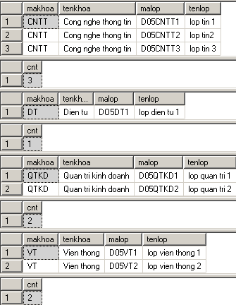
SELECT khoa.makhoa, tenkhoa, malop, tenlop
FROM khoa,lop WHERE khoa.makhoa= lop.makhoa
ORDER BY khoa.makhoa
COMPUTE COUNT(malop) BY khoa.makhoa

Slide 77
Functions in Transact-SQL 3-7
  Date Functions
    Date functions are used to manipulate date values
    They are useful to perform calculations based on dates. Date functions help extract the day, month, and year of a date value, so that each date can be manipulated separately.
    DATEPART refers to the part of the date that is to be extracted and used.
The table shows the valid Dateparts in SQL Server 2005:
Datepart | Abbreviation | Values
Hour | hh | 0-23
Minute | Mi | 0-59
Second | Ss | 0-59
Millisecond | Ms | 0-999
Day of Year | Dy | 1-366
Day | Dd | 1-31
Week | wk | 1-53
Weekday | dw | 1-7
Month | mm | 1-12
Quarter | qq | 1-4
Year | yy | 1753-9999

Slide 78
Functions in Transact-SQL 4-7
The table shows the functions used for Dateparts in SQL Server 2005:
Function | Return Values | Example
GETDATE() | Current system date | SELECT GETDATE()
DATEADD(datepart,number,date) | Date with the specified number added to the specified date part | SELECT DATEADD(mm,4,’01/01/99’) - returns 05/01/99 in the current date format
DATEDIFF(datepart,date1,date2) | Difference between the specified datepart of the two dates | SELECT DATEDIFF(mm,’01/01/99’,’05/01/99’) - returns 4
DATENAME(datepart,date) | A character string for the datepart in the date | SELECT DATENAME(dw,’01/01/2000’) - returns Saturday
DATEPART(datepart,date) | An integer for the specified datepart of the date | SELECT DATEPART(day,’01/15/2000’) - returns 15

Slide 79
Functions in Transact-SQL 5-7
  The table shows the Mathematical functions in SQL Server 2005:
Function | Return Values | Example
ABS(num_expr) | Absolute value of a numeric expression | SELECT ABS(-43) return 43
CEILING(num_expr) | Smallest integer less than, or equal to the specified numeric expression | SELECT CEILING(43.5) returns 44
FLOOR(num_expr) | Largest integer less than or equal to the specified expression | SELECT FLOOR(43.5) returns 43
POWER(num_expr,y) | Value of numeric expression to the power of y | SELECT POWER(5,2) returns 25
ROUND(num_expr,length) | Numeric expression rounded off to the specified integer length | SELECT ROUND(43.543,1) returns 43.500
SIGN(num_expr) | +1 for positive numbers, -1 for negative numbers, and 0 for zeros | SELECT SIGN(-43) returns -1
SQRT(float_expr) | Square root of the specified approximate float expression | SELECT SQRT(9) returns 3
Mathematical Functions
  Mathematical functions perform algebraic operations on numeric values.

Slide 80
Functions in Transact-SQL 6-7
  System Functions
    SQL Server provides system functions for returning metadata or configuration settings.
The table shows the System functions in SQL Server 2005:
Function | Return Values
DB_ID([‘database_name’]) | Database identification number
DB_NAME([database_id]) | Database name
HOST_ID() | Identification number of the workstation
HOST_NAME() | Workstation name
ISNULL(expr,value) | Null expressions replaced with a specified value
OBJECT_ID(‘obj_name’) | Database object identification number
OBJECT_NAME(object_id) | Database object name
USER_ID([‘user_name’]) | User’s database identification number
USER_NAME([user_id]) | User’s database username

Slide 81
ISNULL(expr,value)
P_Id | ProductName | UnitPrice | UnitsInStock | UnitsOnOrder
1 | Jarlsberg | 16.2 | 67 | 15
2 | Mascarpone | 23 | 22
3 | Gorgonzola | 45 | 19 | 20
SELECT ProductName,UnitPrice*(UnitsInStock+UnitsOnOrder)
FROM Products
In the example above, if any of the "UnitsOnOrder" values are NULL, the result is NULL.
SELECT ProductName,UnitPrice*(UnitsInStock+ ISNULL(UnitsOnOrder,0)) FROM Products

Slide 82
Functions in Transact-SQL 7-7
Ranking Functions
  Using Ranking functions, many tasks, like creating arrays, generating sequential numbers, finding ranks, and so on can be implemented in an easier and faster way.
The table shows the ranking functions in SQL Server 2005:
Function | Return Values
ROW_NUMBER() | Returns the number of a row within a result set starting with 1 for the first row
DENSE_RANK() | Returns the rank of rows in a result set without gaps in ranking

Slide 83
ROW_NUMBER() & DENSE_RANK()
ROW_NUMBER ( ) OVER ( [ ] )
SELECT ROW_NUMBER() OVER (ORDER BY Age) AS [Row Number by Age],
FirstName,
Age
FROM Person
SELECT DENSE_RANK() OVER (ORDER BY Age) AS [Dense Rank by Age],
FirstName,
Age
FROM Person

Slide 84
Result by ROW_NUMBER()
Row Number by Age | FirstName | Age
1 | Jonh | 21
2 | Mary | 22
3 | Bin | 22
4 | Jenry | 34

Slide 85
Result by DENSE_RANK()
Row Number by Age | FirstName | Age
1 | Jonh | 21
2 | Mary | 22
2 | Bin | 22
3 | Jenry | 34

Slide 86
Summary
Transact-SQL is an extension of the language defined in the SQL standards published by International Organization for Standardization (ISO) and American National Standards Institute (ANSI).
Data definition language statements are used to build and modify the structure of tables and other objects such as view, trigger, stored procedure and so on.
Data manipulation language is used to select, insert, update, and delete data in the objects defined with Data definition language.
Data control language is used to control permissions on database objects.

